Slide 1
Insurance
Protecting what’s important, so you’re ready for the unexpected

Slide 2
Insurance helps you bounce back
Life is full of surprises ‒ and not all of them are nice.
Insurance is a way to get life back on track when something unexpected happens to your health, your ability to work or your belongings.

Slide 3
An emergency fund is a type of insurance. Some people call this a “safety net”. Having 3 months of expenses set aside is a big help in hard times. But even a smaller safety net of $1,000 can be extremely useful.

Slide 4
Using insurance
Another way to prepare for unexpected events is to get an insurance company to help. When you buy insurance, you and the insurance company agree on:
What you want to protect, like your people or your property.
When something happens, how much you will pay and how much money the company will give you.
How much the insurance costs.

Slide 5
Kinds of insurance
There are lots of different types of insurance. For example:
Car insurance can cover the cost of replacing your car if it is stolen, or the cost of repairing someone else’s car if you hit it.
Pet insurance can cover the cost of your cat’s hip operation.
Home insurance can cover the cost of replacing stolen items, such as your shoes, television, or phone.
You can even get insurance in case you accidentally drop an expensive vase in an antique shop.

Slide 6
Insurance terms
Before you buy insurance, it’s important to learn some vocab.
An insurance policy is a written agreement between you and the insurance company that explains what you are insured for. It’s really important to read this policy carefully.
The premium is the amount you regularly pay for the insurance.
When you ask the insurance company to pay for something that has been lost, damaged, or stolen, you are making a claim.
If your claim is accepted, you usually have to pay some money yourself. This is called the excess.

Slide 7
What’s important to protect?
The things you need to protect change as you grow older.
Car insurance is really important once you start driving. If you hit a BMW, even a small dent can cost thousands of dollars to fix.
If you own a home, you’ll need to insure it in case it gets damaged by a fire or an earthquake.
If you have a family, life insurance can make sure they are looked after once you die.

Slide 8
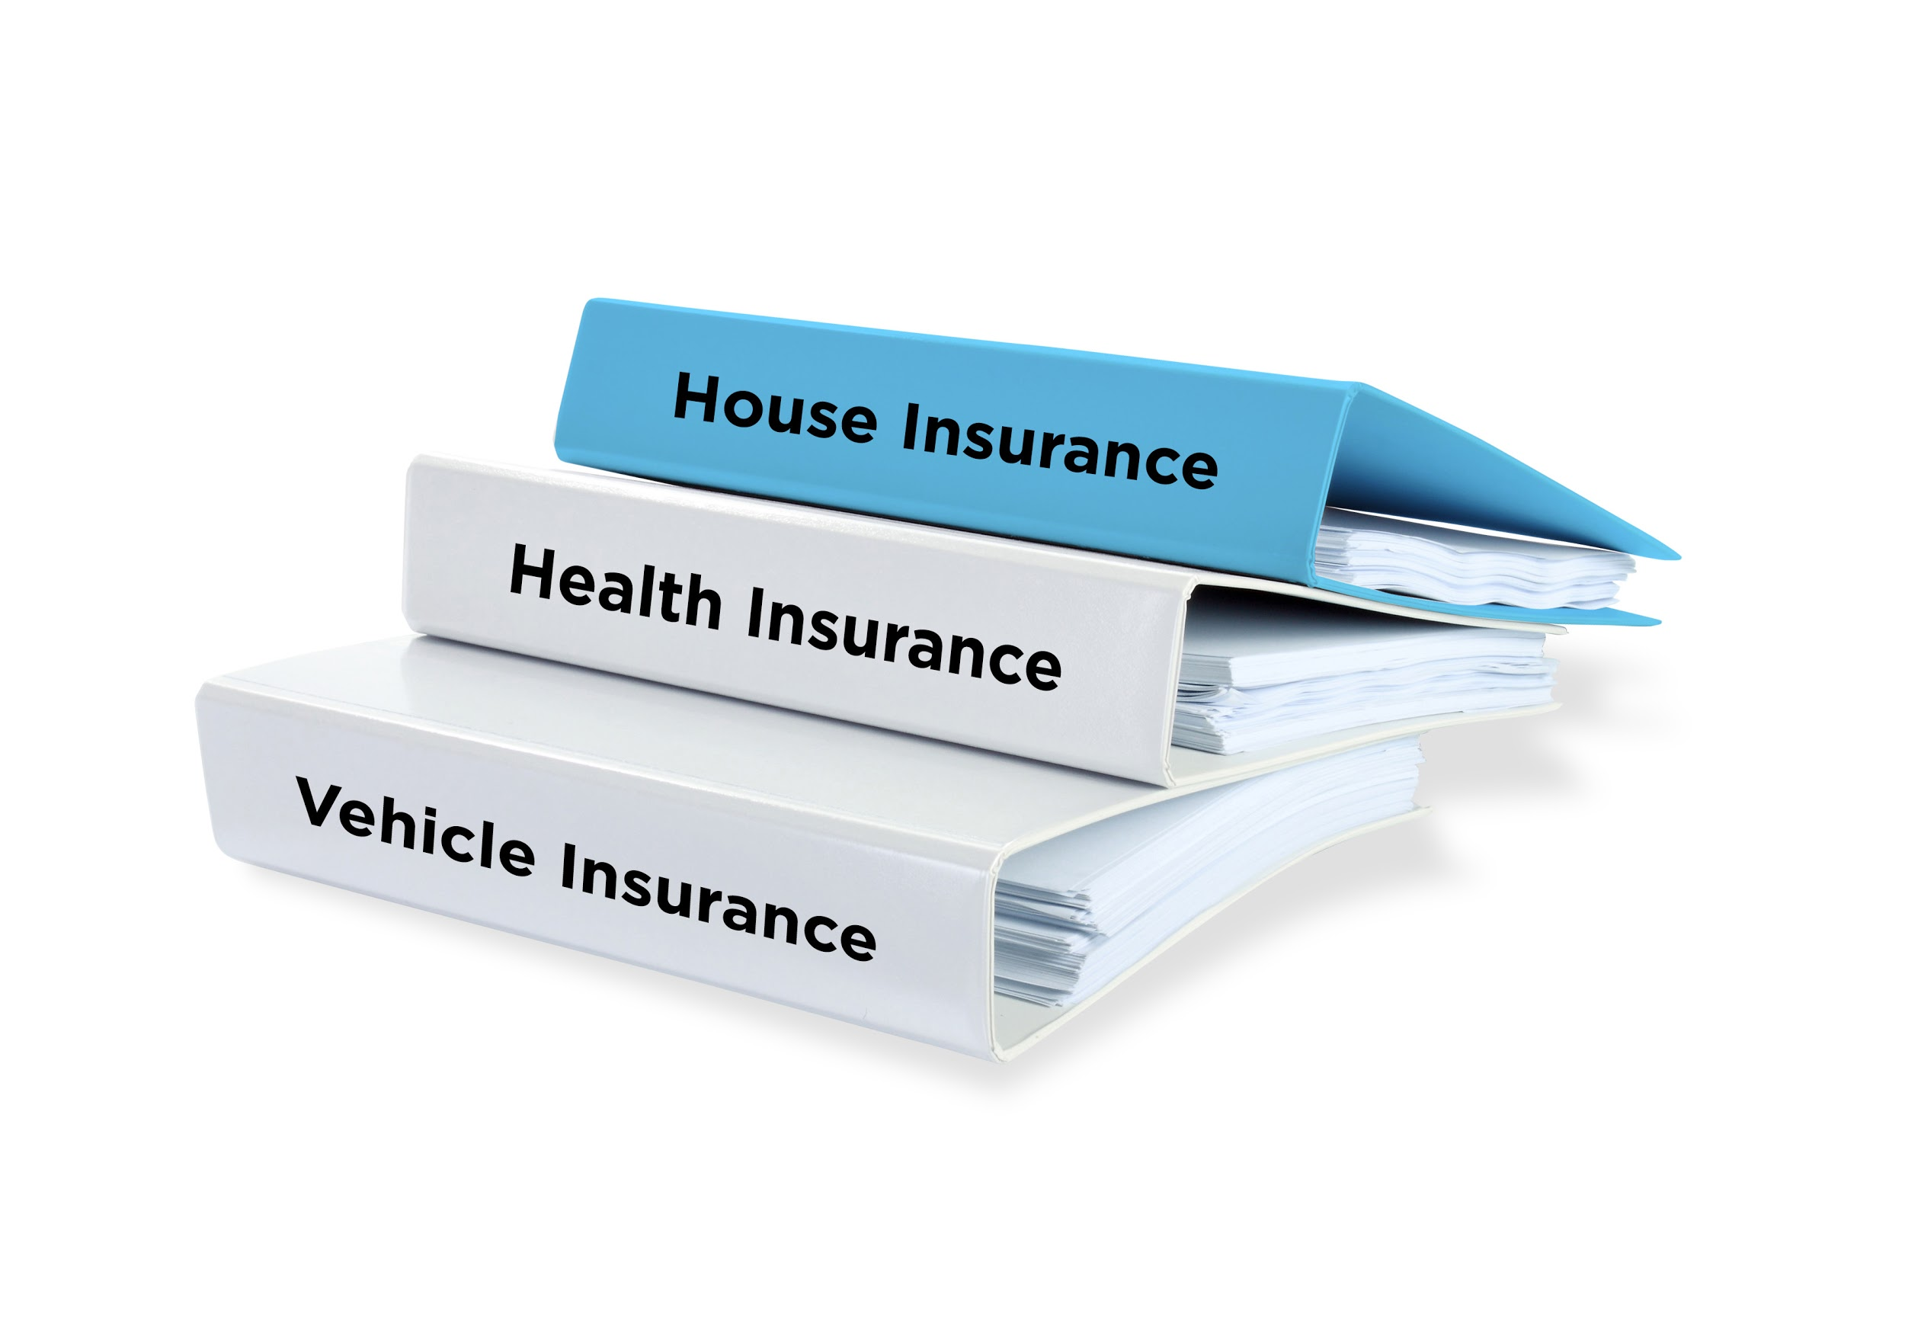
It’s good to shop around for the insurance that suits you best. Buying more than one policy from a company can save you money. Most insurance companies offer special deals for students that cover the costs of both car insurance and renting insurance.

Slide 9
Before you buy
Insurance companies can ask you for personal information before you buy a policy. For example, if you are buying car insurance, they are likely to ask:
How long you have been driving
Whether you have ever had an accident.
It’s important to always tell insurance companies the truth. If you don’t, they might turn down a claim when you make one.

Slide 10
Wills
A will is another way to protect what’s important to you. A will can help make sure that people you are close to are looked after when you die. People use wills to:
Give directions as to what happens to their belongings
Identify who will look after their children
Leave special gifts for people
Make donations to organisations they care about.

Slide 11
Setting aside money to pay for insurance can seem like a big deal at the time. But insurances give you the peace of mind that should the unexpected happen, you’ve protected what’s important.

