Slide 1
KiwiSaver
Investing in your future

Slide 2
What’s KiwiSaver for?
Retirement can seem a long time away, especially when you haven’t even started full-time work.
But you’re never too young to start thinking about your future.

Slide 3
You’re probably going to spend about half of your life earning money. That means that you have 40 or 50 years to save for retirement. If you’re retired for 30 years or more, you’re going to need a good amount of money in the bank by the time you’re 65.

Slide 4
It’s a really good idea
KiwiSaver is a saving and investing system set up by the government to help people get ready for retirement.
Joining KiwiSaver isn’t compulsory, but there are lots of great reasons to join up.

Slide 5
It’s automatic
People who join KiwiSaver put money into their KiwiSaver account each time they get paid. The payments happen automatically, so it’s a really easy way to put money aside.
Investment experts invest the money in your KiwiSaver account for you in shares and bonds so that it grows over time.

Slide 6
You can choose how much of your pay goes automatically into your KiwiSaver account. The options are 3%, 4%, 6%, 8% or 10% of your pay. Your employer has to put in at least 3% of what you get paid as well ‒ that’s extra money that you don’t get if you’re not in KiwiSaver. People can always put in as much as they want extra into their KiwiSaver, too.

Slide 7
Help from the government
The government wants to encourage people to invest in KiwiSaver, so they put money into your account as well. You can get up to $521 from the government each year, just for making regular payments into your KiwiSaver account.
All those extra payments quickly add up to tens of thousands of dollars.

Slide 8
Your first home, too
KiwiSaver funds are mainly for retirement, so even though it’s your money, it stays in your account until you turn 65.
You can also withdraw your KiwiSaver money early if you use it to buy your first home.

Slide 9
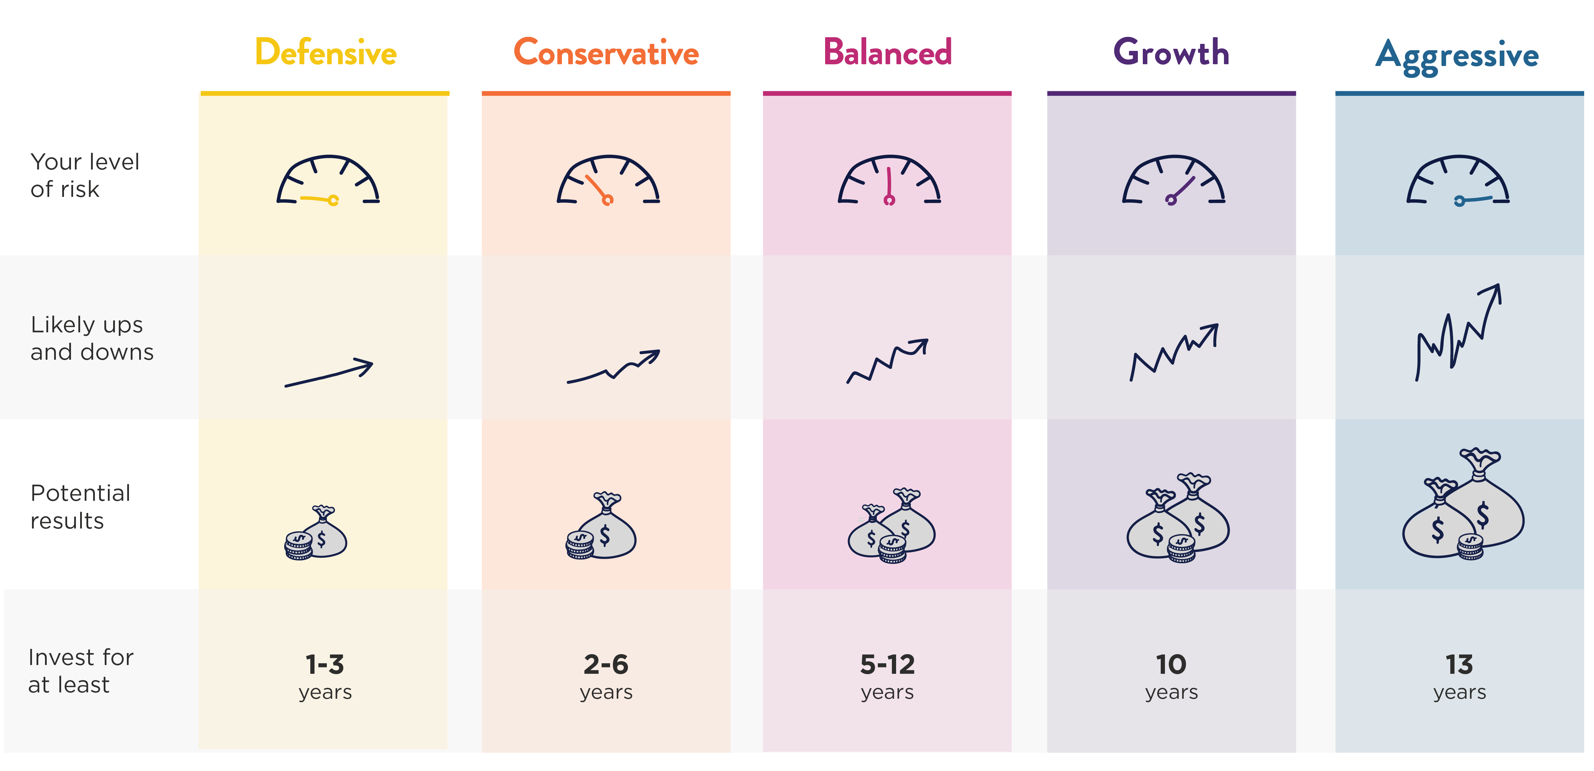
When you invest in KiwiSaver, you have lots of choices. You can choose who manages your money and whether you want your money invested in high- or low-risk investments, or a mixture of both. There are five levels of risk to choose from.

Slide 10
Getting the most out of it
It’s important to keep an eye on your KiwiSaver so you get the most out of it.
That doesn’t mean that you need to know a lot about investing ‒ that’s what you pay your KiwiSaver manager for.
But it might be important to you to know how and where your funds are being invested.

Slide 11
Are you in KiwiSaver yet?
People of any age can start investing in KiwiSaver.
If you have a part-time job, you can already get started investing for your retirement – or your first home – today.

