Slide 1
Managing my money

Slide 2
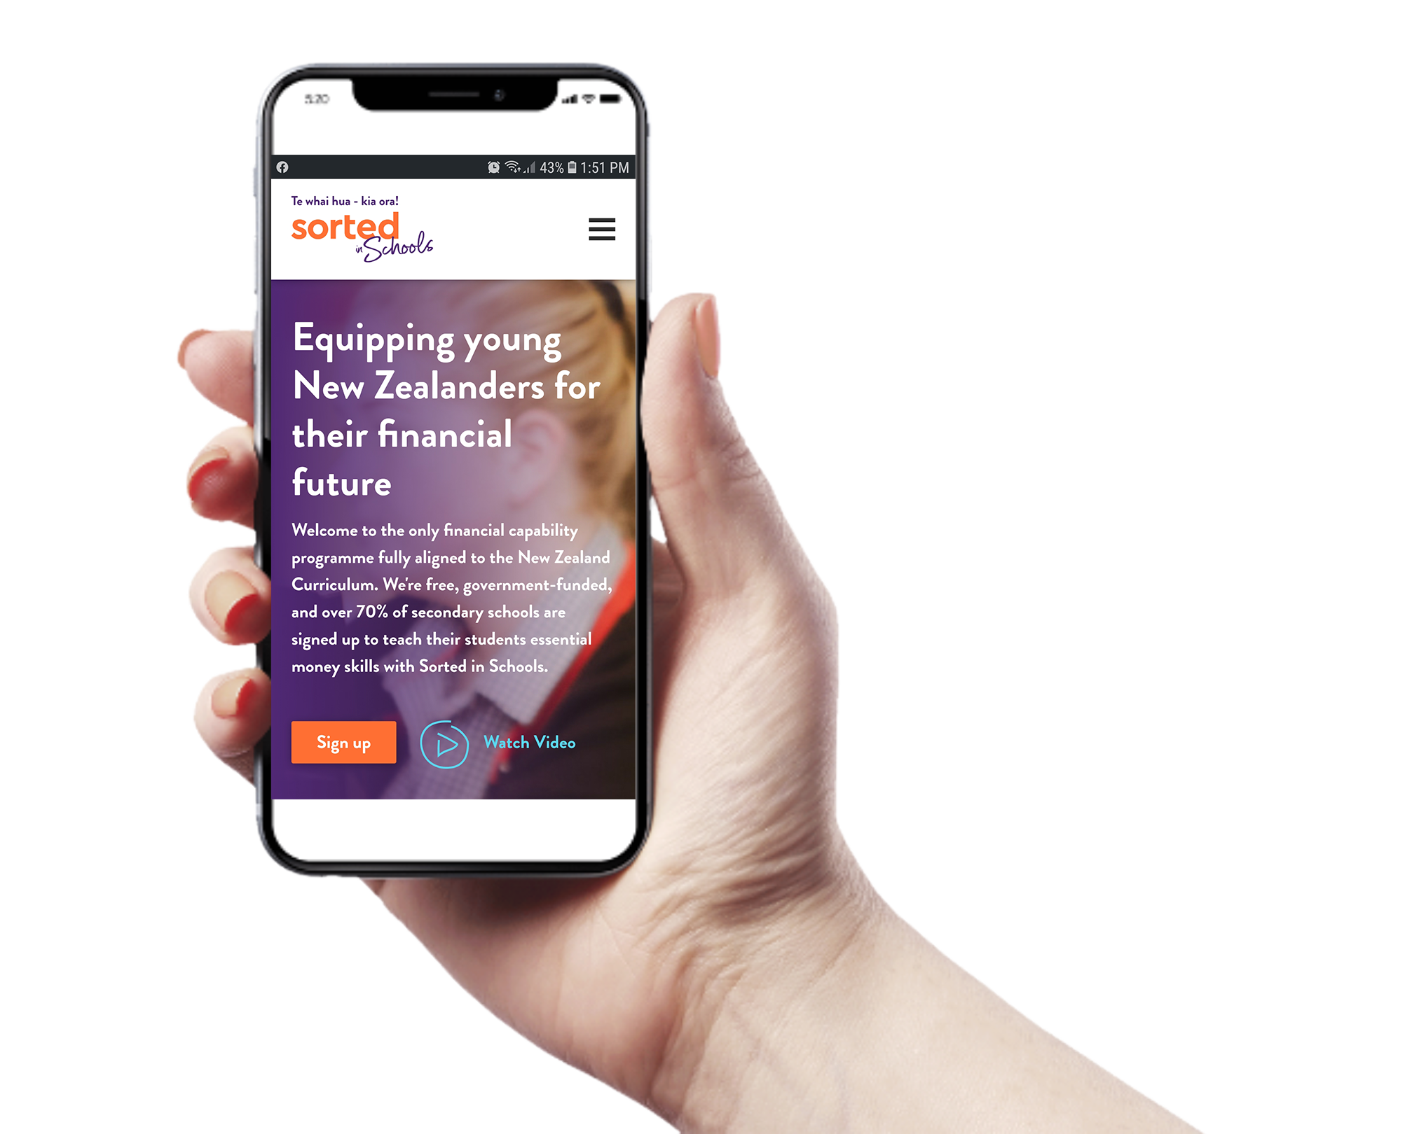
Managing my money
Actively managing my money means regularly looking at my income and tracking where I'm spending it.

Slide 3
To manage money well, there are different options that may better suit different money styles or personal situations.

Slide 4
Managing my money
Managing money well can make a big difference: feeling in control and being able to plan ahead, instead of always wondering where the money went and having difficulty between paydays.

Slide 5
A budget is one tool that can help to manage money. It’s basically a spending plan. It needs to be accurate, or it won’t work.

Slide 6
Building a budget
Here’s what we need:
A record of day-to-day spending
Regular expenses
A list of annual costs
Income
Savings

Slide 7
To manage our money effectively, we add up how much money is coming in (our income), and how much is going out (our spending), then work out the difference.

Slide 8
The result is either money left over (a surplus) or not enough money to cover our spending (a deficit).
The aim is to get a surplus so we have some money left to save for our goals or pay off debt more quickly.

Slide 9
Spending less than is coming in?
With a surplus, we need to work out how much we can save each payday.
This is called ‘paying yourself first’.

Slide 10
Spending more than is coming in?
With a deficit, we need to manage money to see where our money is going.
We can also see if there are areas where we can spend less (or earn more).

Slide 11
When we have a surplus, we can:
Use some of it to build an emergency fund so you don’t need to get into debt for unexpected expenses
Create saving goals.
If we find we have a deficit, we can consider these options:
Check for overspending
Reduce high-cost debt first
Find ways to increase your income.

Slide 12
After deciding how we want to manage our money we need to track how it’s working in reality. We can keep a spending diary or use an online tool or smartphone app. We can then make adjustments as needed.

Slide 13
It’s important to seek help whenever you need it. The MoneyTalks helpline (0800 345 123) can help you find local budgeting services and financial mentors.

