Slide 1
Saving Setting money aside for the things you want

Slide 2
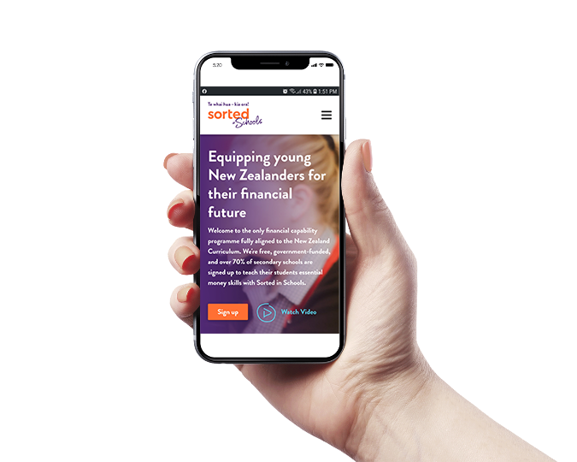
Saving
Saving is setting aside money separately for the things we want.
The more we save, the easier it is to achieve our goals and get ahead.

Slide 3
Saving is better than debt
Many times it’s cheaper to save for stuff – a phone, a car, a holiday – than to borrow to buy them. It just takes some patience.
Saving for the future gives us more options later on and keeps us prepared for anything unexpected.

Slide 4
Saving is a habit to start as soon as you can. One of the best habits we can get into is “paying yourself first” and making it automatic by setting up a separate savings account.

Slide 5
Build a safety net
Your first savings goal should be to build a starter safety net to help with unexpected costs.
As quickly as you can, build a safety net of $1,000. (Sell your extra stuff if you need to even.)
This will help you avoid high-interest borrowing in an emergency, such as to fix your car if it breaks down.

Slide 6
Saving also helps you achieve your longer-term goals, such as building a deposit for a house or retirement through KiwiSaver.

Slide 7
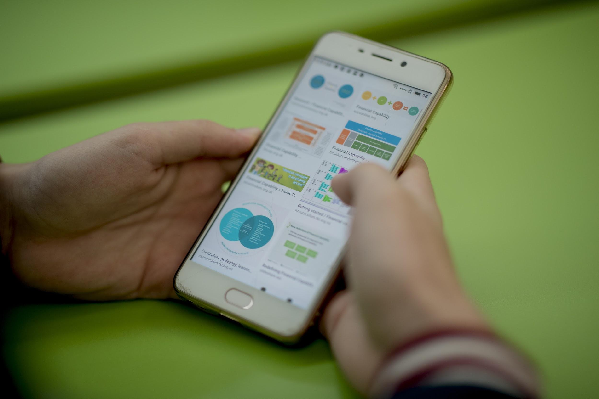
Saving in KiwiSaver
KiwiSaver is a saving and investment system set up by the government to help New Zealanders save for their retirement.
It enables us to save and invest regularly directly from our pay to build a retirement fund for when we stop working.

Slide 8
In KiwiSaver, employees can choose automatically to contribute 3%, 4%, 6%, 8% or 10% of their gross (before tax) wage or salary. Employers have to contribute as well – at least 3% of the gross salary. But everyone can contribute even more if they want to – which grows your money even more.

Slide 9
More than your money flows into your KiwiSaver
Along with employer contributions, there’s a government contribution of $521 every year. It’s a good deal!
An expert from our KiwiSaver company invests our money on our behalf in shares and bonds, which grows our money even more.

Slide 10
Keep your saving on track
Successful saving needs to be:
Little and long – every time you get paid, pay yourself first with at least a small amount.
Purposeful – set a goal for your saving and see how quickly you can get there.
Separate – keep your savings separate from your day-to-day accounts.

