Slide 1
Which company should I invest in to make a return?
Sorted in Schools student template for a group project
Group name:

Slide 2
Summary of Project
Aim: To investigate companies’ revenues comparisons and simulate investing in shares
Time period: 2 - 3 weeks
Number of people in a group: 3 - 4 people
Resources & Equipment
Project presentation template
Spreadsheet tool (e.g. Excel spreadsheet, Google spreadsheet, etc.)
Other useful websites
Outcome: Visual presentation

Slide 3
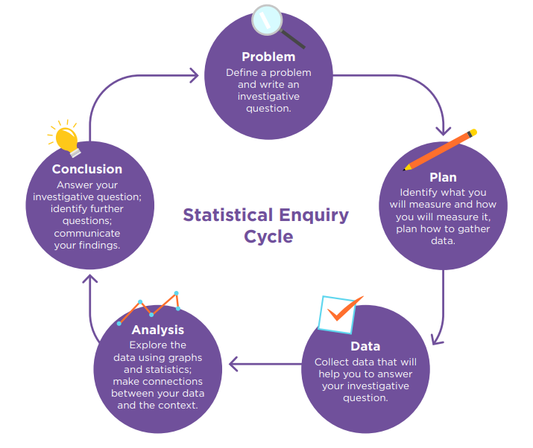
Statistical Enquiry Cycle
To carry out this project a ‘statistical enquiry cycle’ will be used. There are five stages in this cycle:
Problem: formulate a statistical question, what data to collect, who to collect it from and why it is important.
Plan: explain how the data will be gathered.
Data: present how the data is managed and organised.
Analysis: explore and analyse the data, using a variety of data displays, numerical summaries and reasoning with the data.
Conclusion: answer the question in the problem section and give reasons based on the analysis section.

Slide 4
Problem
This project has a clear problem – "Which company should I invest in to make a return?"
Research and write down what you know about the sharemarket.

Slide 5
Plan Part 1. Choose Companies
Which companies are you interested in? Choose two companies you want to compare from the list below.
Industry | Company’s name
Consumer (Food and beverage) | Costco
Technology | Microsoft
Manufactures | Tesla
Health services | Pfizer
Communication services | Facebook
Financial services | Visa
Retail | Amazon
Transportation | American Airlines
Two companies you want to compare:
,

Slide 6
Plan Part 2. Which company seems better placed to grow in the future?
Think about what factors you need to consider when you choose the best company for investing.
Collect the following information about each company and evaluate whether it’s worth investing in or not.
Companies’ revenue for last 10 years (or longer period)
Recent news articles or announcements about the company
Other useful information or statistics
Useful websites: yahoo finance, Macrotrends, TradingView, etc.

Slide 7
Plan
Company A:
Strengths | Weaknesses

Slide 8
Plan
Company B:
Strengths | Weaknesses

Slide 9
Data: Compare company’s revenue history
To compare two company’s revenues for the last 10 years, use Data for investing in shares.xlsx which has the quarterly revenue data of the 8 companies listed from the ‘plan’ stage.
Create a line graph with a trendline on it using a spreadsheet (e.g. Excel spreadsheet). The detailed instruction about how to create a graph is in the ‘Investing in shares – learning material’ resource. Label the graph and paste it here.

Slide 10
Analysis
Using the graph, describe its features to compare both companies. Think about:
What is the overall revenue trends of the two companies over the last 10 years? Have they decreased or increased overall, and by how much?
What are the similarities and differences between the two company’s revenue history?
Are there any unusual features of the graph? What could be the reason why they have happened?
Are there any other interesting features that you want to discuss when comparing the two companies?

Slide 11
Conclusion
Using the analysis of the graph that your group discussed in the previous part, write down which company had the better revenue growth overall.
Company:
Justify your choice using your analysis of the graph:

Slide 12
Let’s find out!
Now you've chosen a company, it's time to simulate an investment – and see what happens!
Assume you invest $1,000 in this company. Let's see what your investment will be like in one week 's time.
Use the table on the next slide to record the company share price each day – for the next seven days.
Calculate how much return you make each day. At the end of the seven-day period, you'll see how much you earned or lost.
This activity illustrates how shares work practically over a short timeframe.
It is important to remember that shares should be considered as a long-term investment.

Slide 13
Let’s find out!
Initial investment (Day 1)
Company Name | Your investment (USD) | Share price (USD) | How many shares (your investment ÷ share price)
 | $1,000
Day 2 to 7
Day | New share price (USD) | Total (No. of shares x new share price) | Profit/loss (Total - $1,000)
Day 2
Day 3
Day 4
Day 5
Day 6
Day 7

